Slide 1
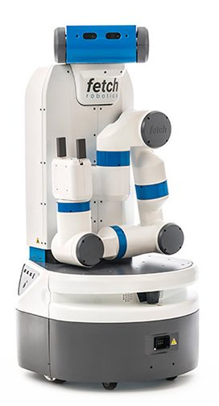
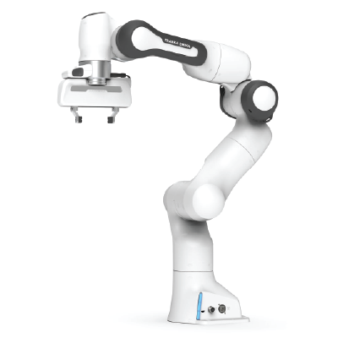

Learning for Interactive Robots Lifelong Robot Library Learning: Bootstrapping Composable and Generalizable Skills for Embodied Control with Language Models
Presenter: Tyler Kim

Slide 2
Presentation Content

